Slide 1

UNIVERSITY OF MESSINA
Department
Cognitive Science and Theory of Communication – LM-55
Course Title
SOCIAL SEMIOTICS
Teacher
Maria Rita Bartolomei
Mail: mabartolomei@unime.it

Slide 2

SOCIAL SEMIOTICS
Affordances
the potential uses of a given object
they stem directly from their observable properties
Modes have different affordances
Each mode has its specific potential, its affordances for making meaning

Slide 3
SOCIAL SEMIOTICS
Affordances
different observers might notice different affordances
Affordances are objective, but perception is selective
The meanings we find in the world are both objective and subjective
All their uses take place in a social context and might have
different cultural and social meaning

Slide 4
SOCIAL SEMIOTICS
The term “meaning potential”
focuses on meanings which have already been introduced into society
The term “affordance”
also brings in meanings which have not been recognized,
which are waiting to be discovered
The meaning potential – affordance of a semiotic resource
consists of all their past, present and future uses

Slide 5
SOCIAL SEMIOTICS
Modes have meaning in their cultural environments
The meaning-potential of modes are the effect of the work of individuals as members of their society
These meaning-potentials become part of the cultural resources of any one society

Slide 6
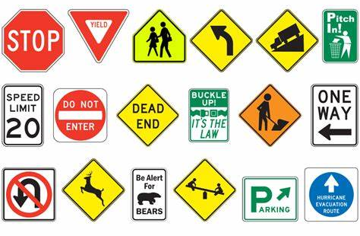

SOCIAL SEMIOTICS
Traffic signs Abstract art

Slide 7
SOCIAL SEMIOTICS
Social semiotics
is a new and distinctive approach which
investigates how semiotic modes can be integrated in multimodal artefacts and events
investigates how these resources are used in specific historical, cultural and institutional contexts

Slide 8
SOCIAL SEMIOTICS
Semiotic resources
have specific forms in different cultures
The concept of “plural meanings” is crucial here.

Slide 9

SOCIAL SEMIOTICS
Red colour
danger, passion, murder

Slide 10



SOCIAL SEMIOTICS
Danger

Slide 11


SOCIAL SEMIOTICS
Passion

Slide 12



SOCIAL SEMIOTICS
Blood, murder

Slide 13


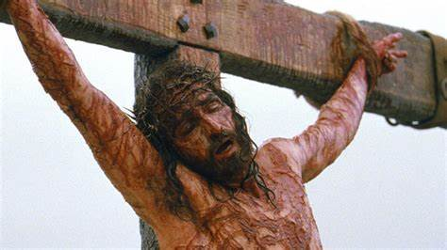
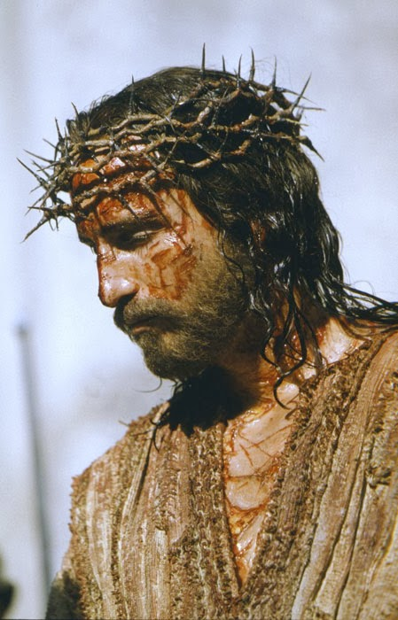
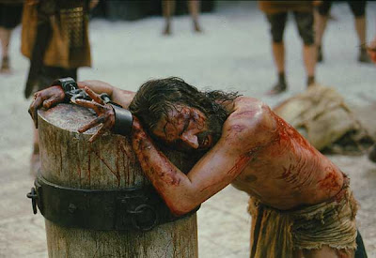
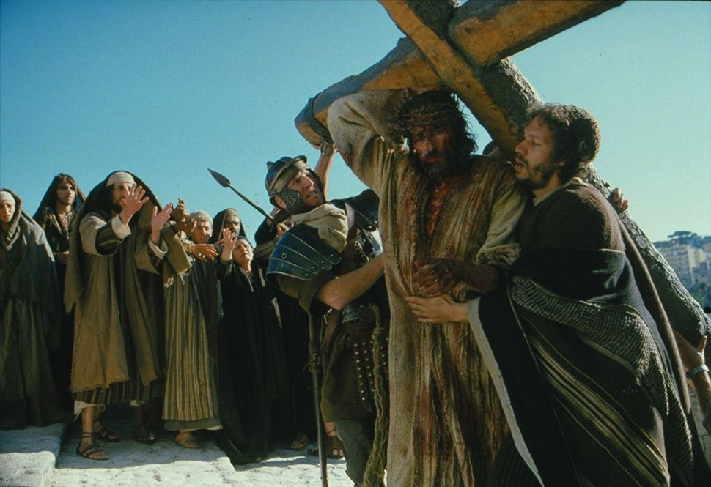

SOCIAL SEMIOTICS
Passion

Slide 14
SOCIAL SEMIOTICS
Social semiotics
is a branch of the field of semiotics
collects, documents and catalogues semiotic resources
compares semiotic modes (image, music, and so on)
contributes to the discovery and development of new semiotic resources
has much in common with cultural studies and critical discourse analysis

Slide 15
SOCIAL SEMIOTICS
Semiotic resources
are not restricted to speech and writing and picture making
almost everything we do or make allows the articulation of different social and cultural meanings
Walking could be an example
There are different ways of walking

Slide 16
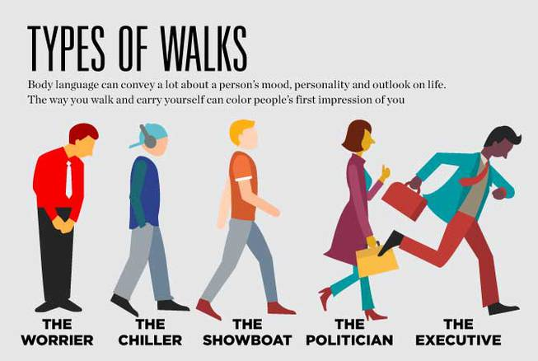
SOCIAL SEMIOTICS
There are different ways of walking

Slide 17

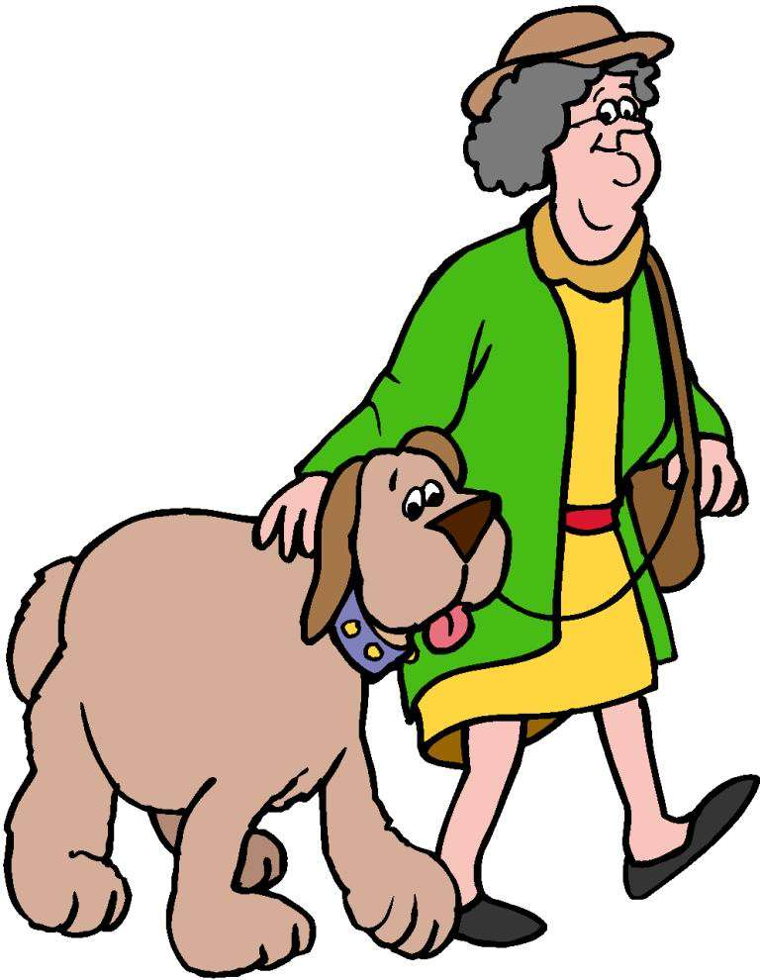


SOCIAL SEMIOTICS
There are different ways of walking

Slide 18
SOCIAL SEMIOTICS
From a Social semiotics perspectives
Signs are not fixed into unchanged codes
Signs are resources which people use, design and adapt to make meaning
Signs cannot be separated from concrete forms of social relations and cannot exist without it
All social resources take place in a social context and might have different cultural and social meaning
There are social meaning-making processes of many types: verbal, written, visual, musical, aural, and so forth
These different resources can also be joined in multimodal ensembles

Slide 19
SOCIAL SEMIOTICS
Social semiotics – A theory which deals with meaning
in all its appearances
in all social occasions
in all cultural sites

